Slide 1







INTERNET OF VEHICLES (Iov) BASED ANDROID APP DEVELOPMENT PROJECT GUIDED BY Dr. SRIRAMULU BOJJAGANI
PROJECT CARRIED OUT BY
AP18110010421
AP18110010444
AP18110010456

Slide 2
ABSTRACT
The internet of vehicles (Iov) is regarded as an extension of the V2V communication network. With the assistance of vehicle artificial intelligence (AI) knowledge of other vehicles and their behaviour, the internet of vehicles (Iov) helps to improve driving aids. Iov is linked in an ad hoc networking environment called a vehicular ad hoc network (VANET), which uses each vehicle in the network as a node. Where the vehicles may also be connected to the public Internet. It is particularly important for autonomous vehicles since they can interact with other vehicles in their immediate vicinity. Furthermore, in order to maintain safe and smart transportation, it is important to avoid accident-prone areas. In the Internet of Things, protection becomes important because any device failure has a direct effect on user safety. From an Iov viewpoint, we address security problems, various security threats, and their countermeasures in this paper. In the Iov, we also suggest an authentication method for (V2I) vehicle-to-infrastructure communication.

Slide 3
INTRODUCTION
The Internet of Vehicles (Iov) technology forced vehicle hardware to advance by installing various intelligent devices, processors, and sensors inside the vehicle that include accessorised parts of the car and external sensors including cameras, location tracking, some sensors for drivers, sensors to analyse the physical, mental, and emotional condition of the driver, actuators providing a multisensory platform, and many more.
In our Project, we developed an Android app. Here the Vehicle to device connection has happened. In this app, we make GPS connectivity also that’s why we can view a map and as well as directions.

Slide 4
SOFTWARE REQUIREMENTS USED:
Mobile Name: Samsung Galaxy A30s
Processor: Octa –core Exynos 7904
RAM: 4GB
Operating System: One UI 2.0
Version: Android 10 which is the latest updated version.
HARDWARE REQUIREMENTS USED:
Android studio: version 4.2
Operating system: Android studio
8 GB RAM is required
2 GB disk space availability is required
4 GB is Recommended (500 MB for IDE + and 1.5 GB for Android SDK and
emulator system image)
1280 x 800 minimum screen resolution is required
Data base used : Sqlite
​

Slide 5
PROPOSED SYSTEM
Iov based android app development is proposed to replace the RTO office work.
This application allows user to easily register their vehicle details such as registration number, vehicle model, and other information required.
This App is versatile and user-friendly.
And the amount of time taken to get the details and other information will be reduced.

Slide 6
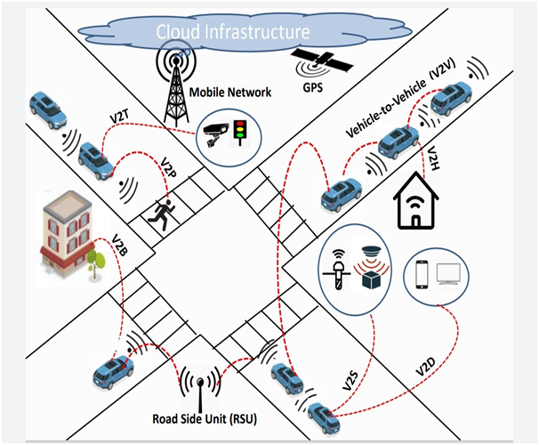
An architecture of internet of vehicles(Iov) concerning smart cities
This architecture shows us the functionality of internet of vehicles in smart cities
Cloud infrastructure refers to the hardware, abstracted resources, storage, and network resources needed for cloud computing. Cloud infrastructure is needed to host cloud services and applications.

Slide 7
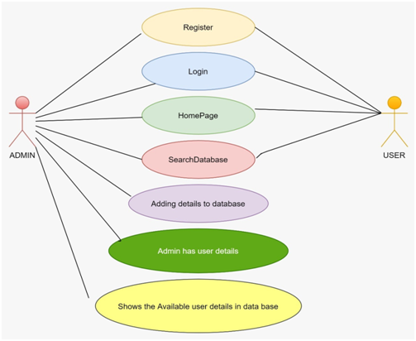
DESIGNING
USE CASE DIAGRAM

Slide 8
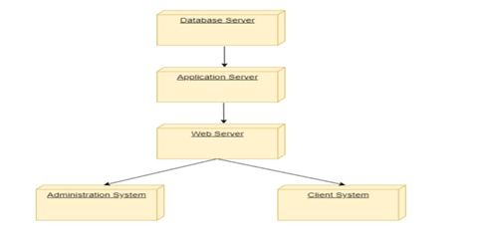
DEPLOYMENT DIAGRAM

Slide 9
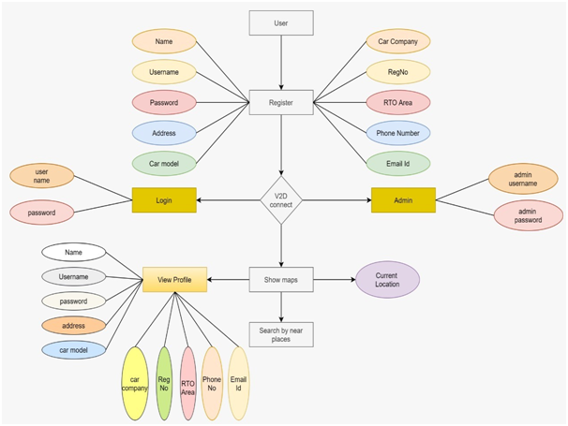
ER DIAGRAM

Slide 10
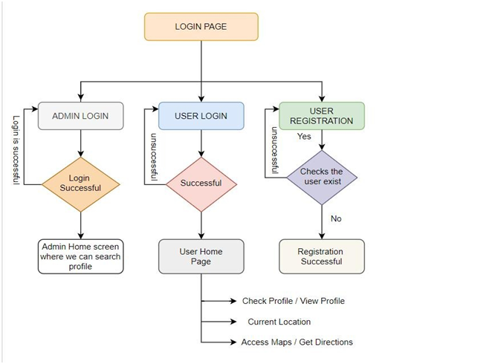
WORK FLOW

Slide 11
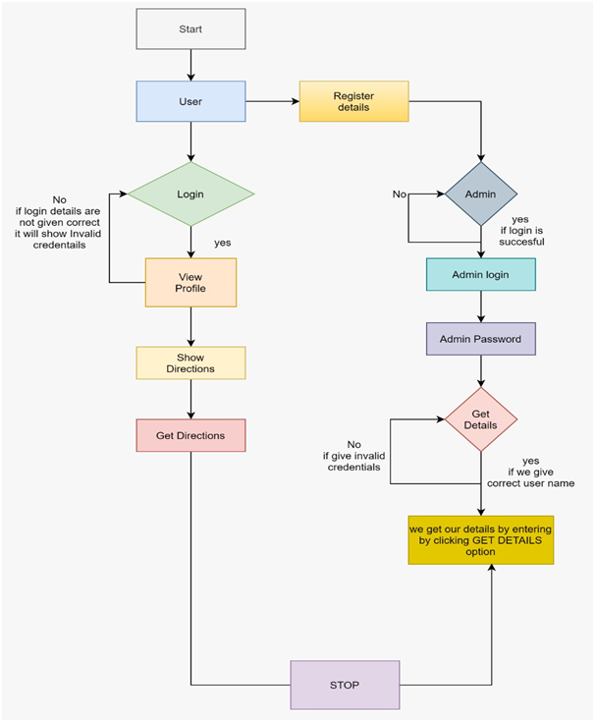
FLOW CHART

Slide 12
IN DEVELOPING ANDROID APP WE MADE THE FOLLOWING PAGES
● LOGIN PAGE
● REGISTRATION PAGE
● HOME PAGE
● VIEW PROFILE PAGE
● SHOW MAPS PAGE
● DIRECTIONS PAGE
● ADMIN LOGIN PAGE
● GET DETAILS PAGE

Slide 13
Login Page :- The purpose of this login page is in this user can login by giving his details i.e username and password and also new user should has to register the details so that he can login by giving user name and password so that the login is successful
Registration Page:- The purpose of this page elaborates that the new user have to register the details himself by giving his name, address, car model, car company, registration number, rto area, phone number, email id etc so that the registration is successful.
Home Page:- This page has various options are available to the user i.e . as user can view the profile,and get his current location and can search places.
View Profile Page:-In this page where user can click the option and can see all the details like car model, car company and rto details without going to rto office to verify his all details which is convenient for user.

Slide 14
Show Maps Page:-The purpose of this page in this module when user clicks on show maps option he is able to get the access of his current location so that he can know his current location and as this option will be helpful when user doesn’t know his current location.
Direction Page:-This page where we can search the places that he want and he can also be able to get directions from the current location in the app only without getting redirected to the google maps.
Admin Login Page:- In This page in our app we have provided admin login to monitor how many users are registered , to see all the details are safe, any user registered multiple times with same details so that there will not be fake login and all the details are correct i.e phone number entered by the user is 10-digit or not etc.
Get Details Page:-The purpose of this page In the get details option admin can get all the user details by entering username. and if any of the registered user want his details he can contact admin in case where he forgot his registered password and his details are also preserved as no 3rd party can view his details so that there will be no security issues.

Slide 15
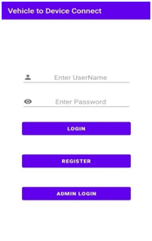
LOGIN PAGE

Slide 16
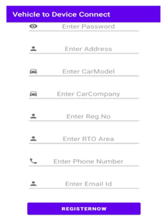
REGISTRATION PAGE

Slide 17
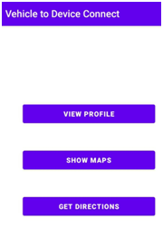
HOME PAGE

Slide 18
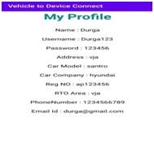
VIEW PROFILE PAGE

Slide 19
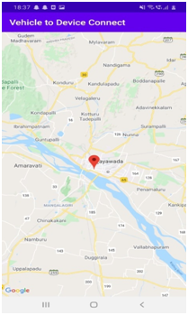
SHOW MAPS PAGE

Slide 20
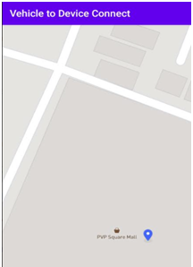
DIRECTIONS PAGE

Slide 21
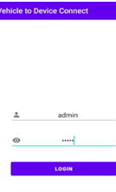
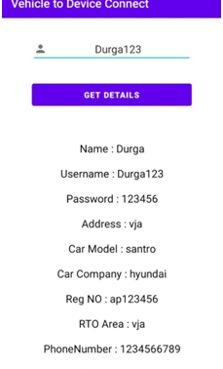
ADMIN LOGIN PAGE
GET DETAILS PAGE

Slide 22
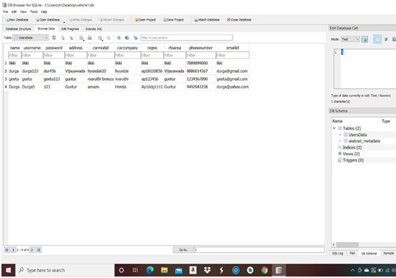
SAMPLE DATA BASE VALUES INSERTED IN SQLite DATA BASE FOR THIS APP

Slide 23
GOALS:
The main goal of this project is to simplify the process of information management in any RTO office.
It helps the management to maintain the information about the users vehicle. Thus it helps the management to maintain the records in a systematic order and also to access details very quickly.
This can be implemented in all RTO offices to proceed the office works smoothly.
This entire system is managed by a system administrator, who has complete system power, to read, write and executes the results, and grants access to admin and user.
BENFITS:
Eco-friendly: You can avoid paperwork.
Effective user Data Management.
Supervise user information.

Slide 24
CONCLUSION
In the recent times the usage of smart applications based on Iov (Internet of Vehicles) had been increased rapidly not only in the developed countries like U.S, U.K but also in developing countries like India, China etc which are user convenient and makes user work very easy. Many car manufacturing companies like MG Hector, Maruti Suzuki are developing their individual applications for their customer convenience. But this usage of smart applications are causing many privacy and security related issues. In this paper we focus on development of Iov system and the security issues related to Iov. In our proposed work we have developed an mobile application which ensures user security and makes user work convenient i.e. to know or verify his details without going to RTO Office. The user of this app can know his current location, can search for nearby places etc. using this app. This app provide multiple options for the registered users so that the users need not provide their data in the unsecured apps that are available online.

Slide 25


